Slide 1
Lab 2
Descriptive Network Analysis - Local and Global Properties

Slide 2
Agenda
Local Network Properties
Global Network Properties
Q&A

Slide 3






Dataset from Lab 1
load('Lab1_Descriptive.RData')
vs.

Slide 4
Local & Global Network Properties
Local properties let us examine the positions that individuals hold within a network
Global properties provide a language for describing networks as a whole and making comparisons between networks

Slide 5
Part III: Local Network Properties
Degree
Betweenness
Closeness
Eigenvector
Burt’s network constraint

Slide 6
Part III: Local Network Properties
Describe each centrality measure (i.e., what does it mean to have a high degree centrality? A high network constraint score?)
Why did we exclude hub and authority centralities from our analysis?
Notes:
Burt’s constraint - lower is better; still show it

Slide 7
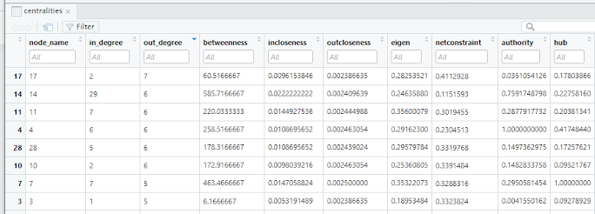

Part III: Local Network Properties
Provide a table ranking the top 5 nodes for each centrality measure
Caveat: Burt’s network constraint
Notes:
Burt’s constraint - lower is better; still show it

Slide 8
Part IV: Global Network Properties
What is k-core?
What is community detection?
What is a modularity score?
What is the power-law test?
What is a small-world network

Slide 9
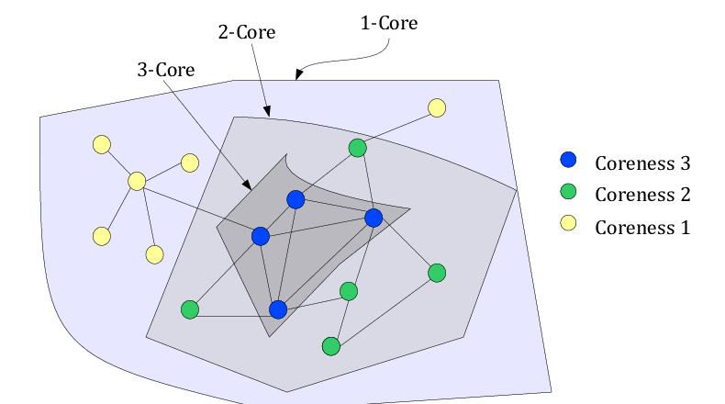
k-Core
A connected subgraph which has minimum degree greater than or equal to k
Notes:
a k-core is obtained by recursively removing all nodes of degree smaller than k, until the degree of all remaining vertices is larger than or equal to k.
Recommendation and anomaly detection
Note that by definition cores are “concentric”, meaning that nodes belonging to the 3-core belong to the 2-core and 1-core, as well. Larger values of “coreness”, though, clearly correspond to nodes with a more central position in the network structure.

Slide 10
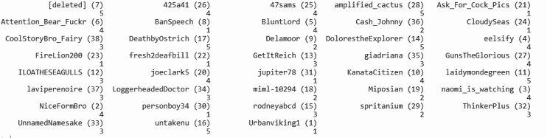
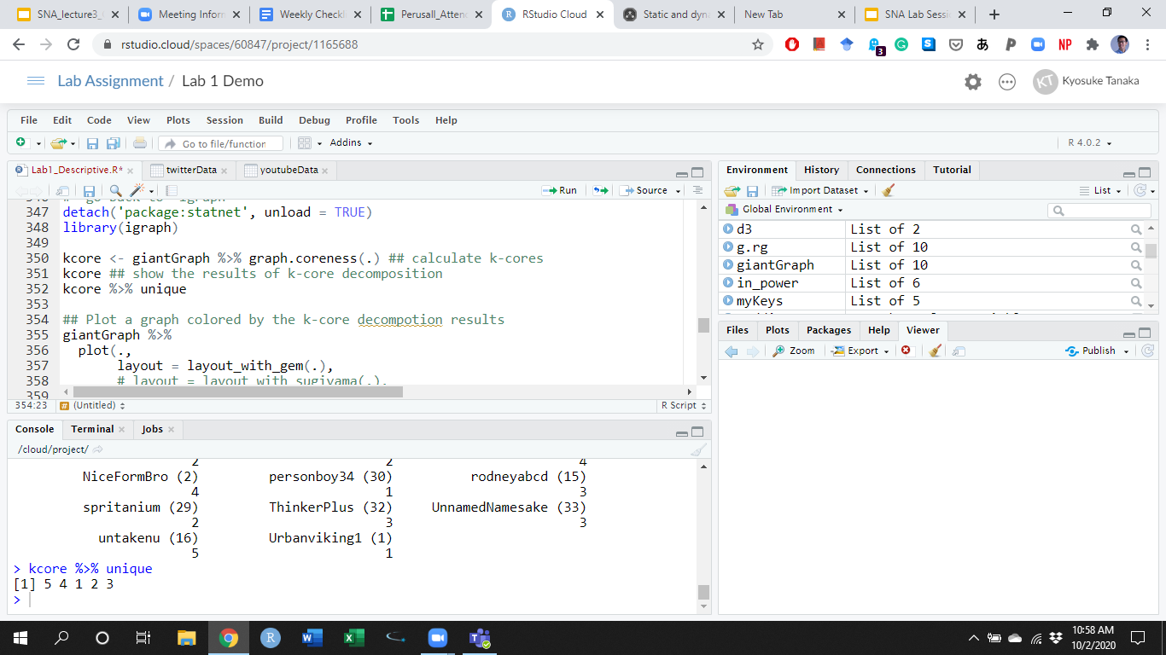
k-Core in R
kcore <- giantGraph %>% graph.coreness(.)
kcore
unique(kcore)

Slide 11
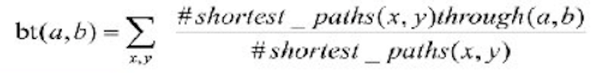
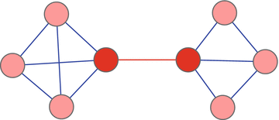
Community Detection
Identify communities/subgroups in a network
e.g., the Girvan-Newman algorithm (edge betweenness approach)
Calculate the betweenness of all existing edges in the network
Remove the edge(s) with the highest betweenness
Recalculate the betweenness of all edges affected by the removal
Repeat Steps 2 and 3
c
f
d
a
b
g
16
1
5
5.5
e
h
Notes:
the number of shortest paths between vertices that contain the edge
Higher edge betweenness meaning higher likelihood of situating on the shortest path between nodes, meaning that higher likelihood of situating BETWEEN two clusters/subgroup.
e(b,h) = {b,h}, {a, b, h}, {d, a, b, h}, {c,a,b,h}, {e,a,b,h}, {f,b,h}/{f,g,h}

Slide 12
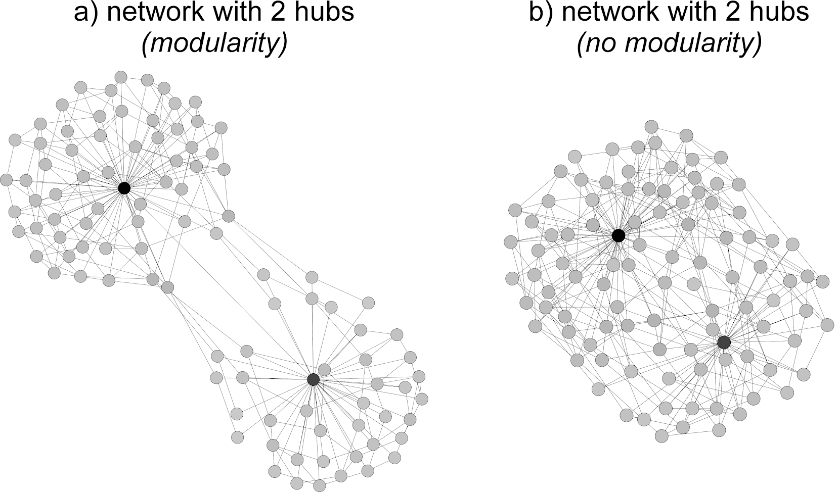
Modularity
A measure of the strength of division of a network into communities/subgroups
High modularity (close to 1) indicates more edges within the community than you expect by chance
Conservatives
Liberals
Notes:
Measure the success of community detection.

Slide 13
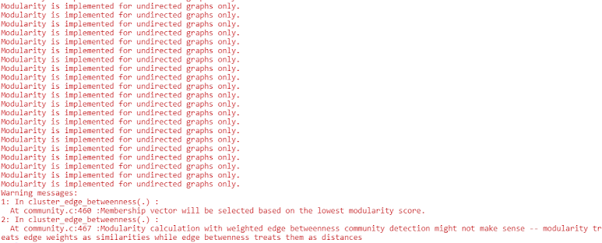
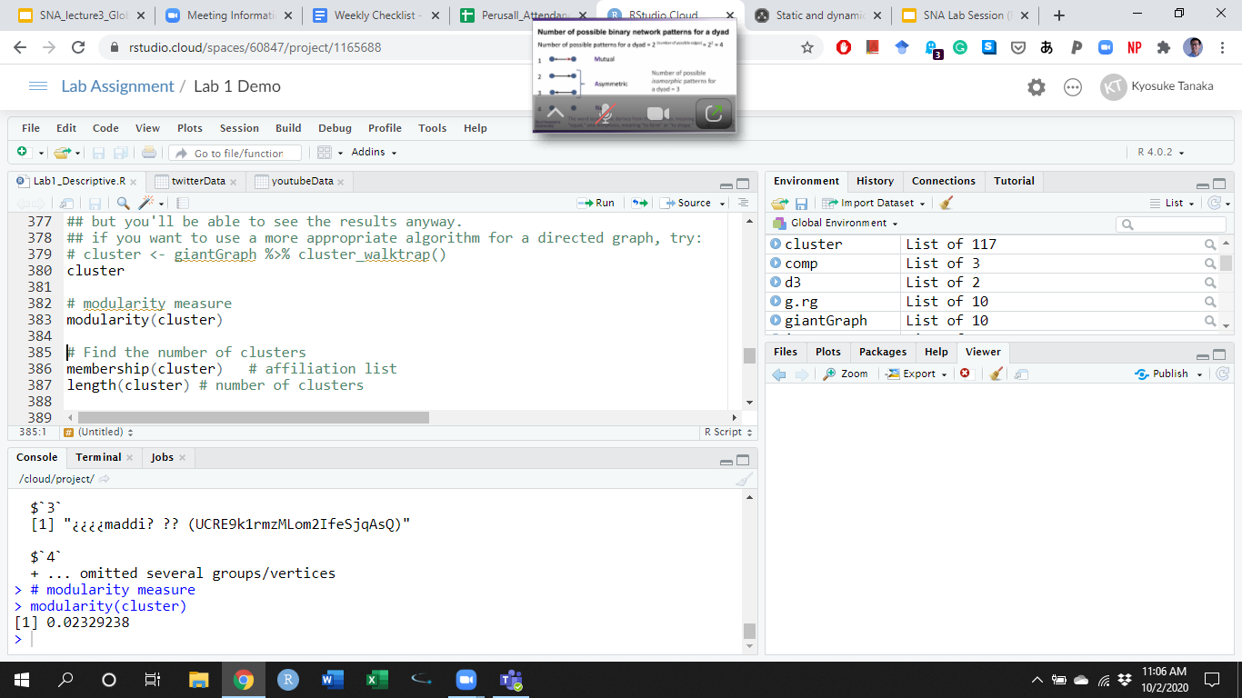
Community Detection & Modularity in R
cluster <- giantGraph %>% cluster_edge_betweenness() # if you’re interested in different algorithms (see Yang et al 2016 SR)
modularity(cluster)

Slide 14
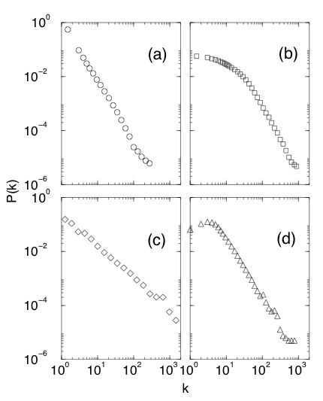
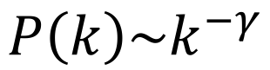
Power-law Degree Distribution
Internet routers
Movie actors
ᵞ
ᵞ
ᵞ
ᵞ
Physicists
Neuroscientists

Slide 15
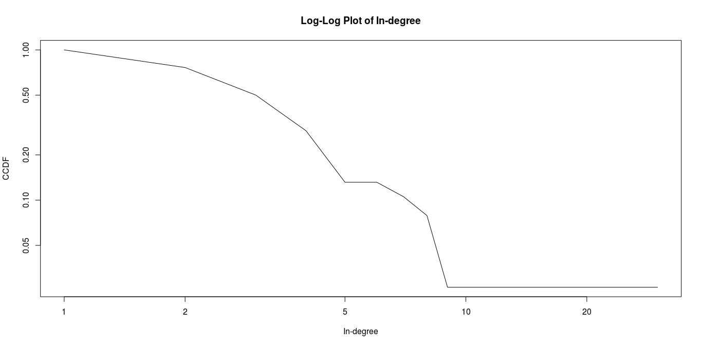
Power-law Degree Distribution in R
giantGraph %>%
degree.distribution(.,cumulative = TRUE,mode ='in') %>%
plot(1:(max(degree(giantGraph,mode='in'))+1),., ## since log doesn't take 0, add 1 to every degree
log='xy', type = 'l',
main = 'Log-Log Plot of In-degree',
ylab = 'CCDF',
xlab = 'In-degree')

Slide 16

Power-law Test in R
in_power <- giantGraph %>%
degree.distribution(., mode='in') %>%
power.law.fit(.)
in_power
Q: Is my in-degree distribution a power law?
A: if KS.p > 0.05, yes. If KS.p < 0.05, no.
Notes:
then you’re going to calculate your gamma value - denoted as “alpha” in the R output
Then we test whether this data is really representative of a power law distribution, and to test that we use the Kolmogorov-Smirnov test in which the null hypothesis is that the in-degree distribution is the same as the power law distribution, and the alternative is that they are not the same.
so you look at the p-value

Slide 17
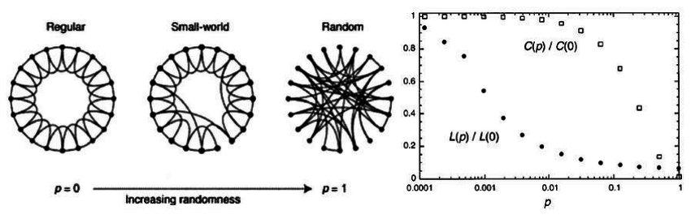
Small-world Networks
Global Clustering Coefficient
Average Shortest Path
Where does your network fall in this spectrum?

Slide 18
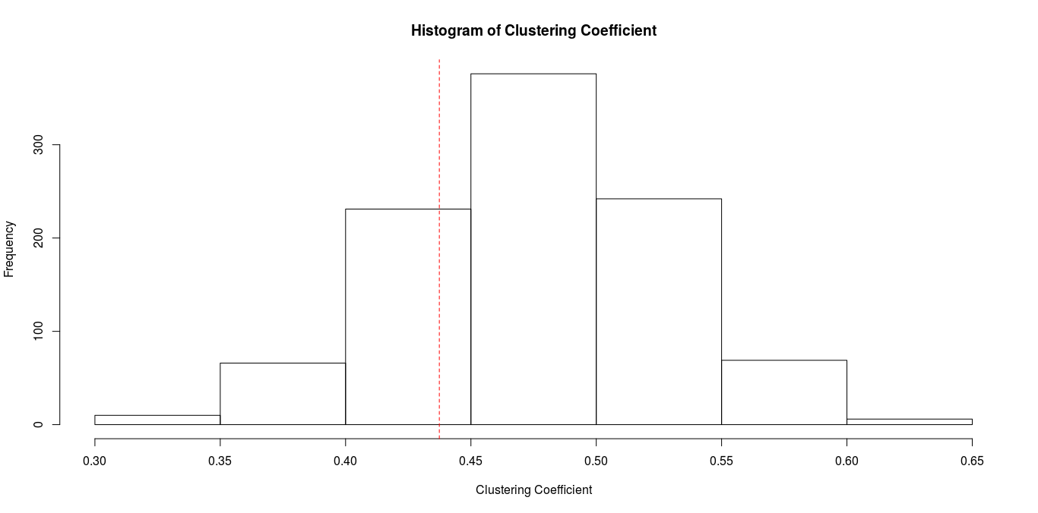
Small-world Networks in R
hist(cl.rg,
main = 'Histogram of Clustering Coefficient',
xlab = 'Clustering Coefficient')
par(xpd = FALSE)
abline(v = giantGraph %>% transitivity(., type = 'average'), col = 'red', lty = 2)
This line indicates the global clustering coefficient value of my network

Slide 19
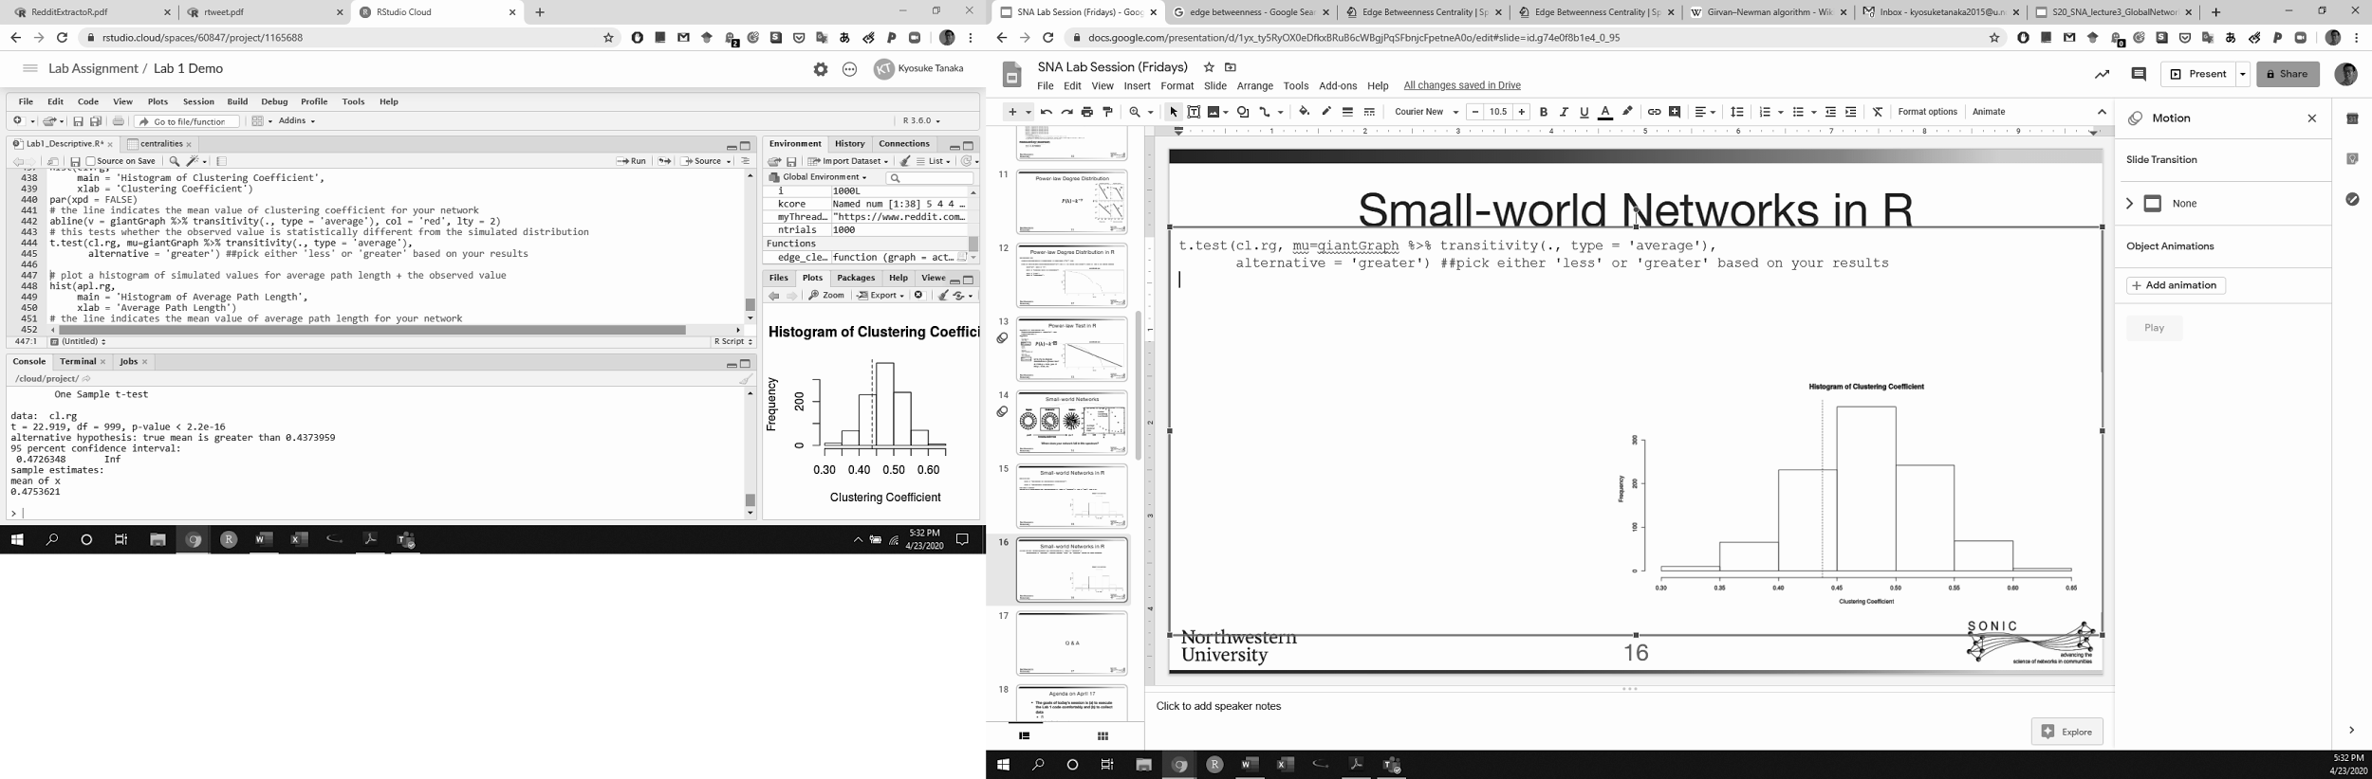


Small-world Networks in R
t.test(cl.rg, mu=giantGraph %>% transitivity(., type = 'average'),
alternative = 'greater') ##pick either 'less' or 'greater' based on your results
t.test(cl.rg, mu=giantGraph %>% transitivity(., type = 'average'),
alternative = 'less') ##pick either 'less' or 'greater' based on your results
Q: Is the global clustering coefficient of random networks greater than my network’s?
A: If p < 0.05, yes. If p > 0.05, no.
Q: Is the global clustering coefficient of random networks less than my network’s?
A: If p < 0.05, yes. If p > 0.05, no.
Notes:
Then you’re going to compare the empirical value for our network to the simulated distribution and what we want to know is - is our network’s clustering coefficient bigger or smaller than the clustering coefficient of the random networks. To test this, you use a one-tailed t-test.
Then the question is - does this satisfy the properties of a small world network? The answer in this case is no, because we would expect our network’s clustering coefficient to be greater than the randomly generated ones.

Slide 20
Q & A

